Slide 1
Forecasting the rate of Spread of COVID-19
Submitted By:
Ashwin Goyal - 01711502818
Kartik Puri - 03811502818
Department of Electrionics and Communication Engineering
Bharati Vidyapeeth’s College of Engineering, New Delhi

Slide 2
Table of Contents
Introduction
Proposed Framework/Problem Statement
Dataset
Methodology
Evaluation Metrics
Results and Analysis
Conclusion and future work
References

Slide 3
INTRODUCTION
The 2019 novel coronavirus also known as SARS-Cov-2, generally known as COVID-19 virus has spread all over the world. On March 11 2020, World Health Organisation (WHO) declared the 2019 novel corona virus as global pandemic. Corona virus, was ﬁrst originated in Wuhan, China.
In recent days, Covid19 has been an immense impact on social, economic ﬁelds in the world. It is necesssary to quantify its spread and make predictions on how it is going to aﬀect the world in coming months.
In this paper, our aim is to use linear regression and LSTM algorithms to forecast of Covid19 spread. The objective of this study is to determine if spread can be forecasted using linear regression and LSTM algorithms and comparing their result to check which model predicts better

Slide 4
PROBLEM STATEMENT
The goal is to predict or forecast the number of COVID-19 cases using machine learning and deep learning techniques i.e. using LSTM(Long Short Term Memory units) and linear regression and compare the accuracy and error.

Slide 5
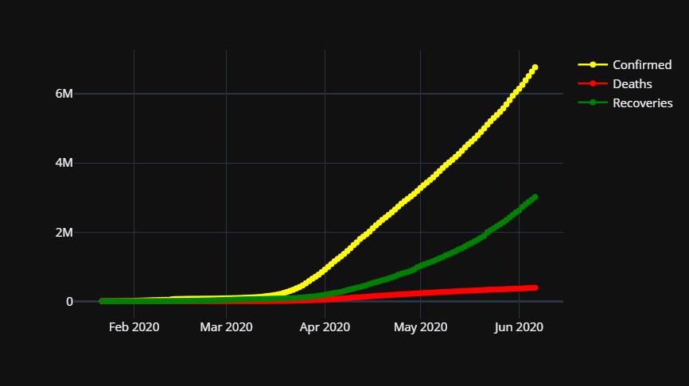
DATASET
The dataset used was the 2019 Novel Coronavirus Dataset operated by the Johns Hopkins University Center for Systems Science and Engineering (JHU CSSE).
It consist of 3 dataset each of Death, Confirmed, Recovered cases of 188 countries date-wise. The number of date columns are 138 starting from 22 Jan,2020 to 8 June,2020.Out of this about 85% are used as training data and the rest used as testing and validating data. So the model would be predicting next 15% data value i.e. the testing data values.
The prediction would not be made on a specific country rather it will be worldwide. The following graph shows the number of cases worldwide:

Slide 6
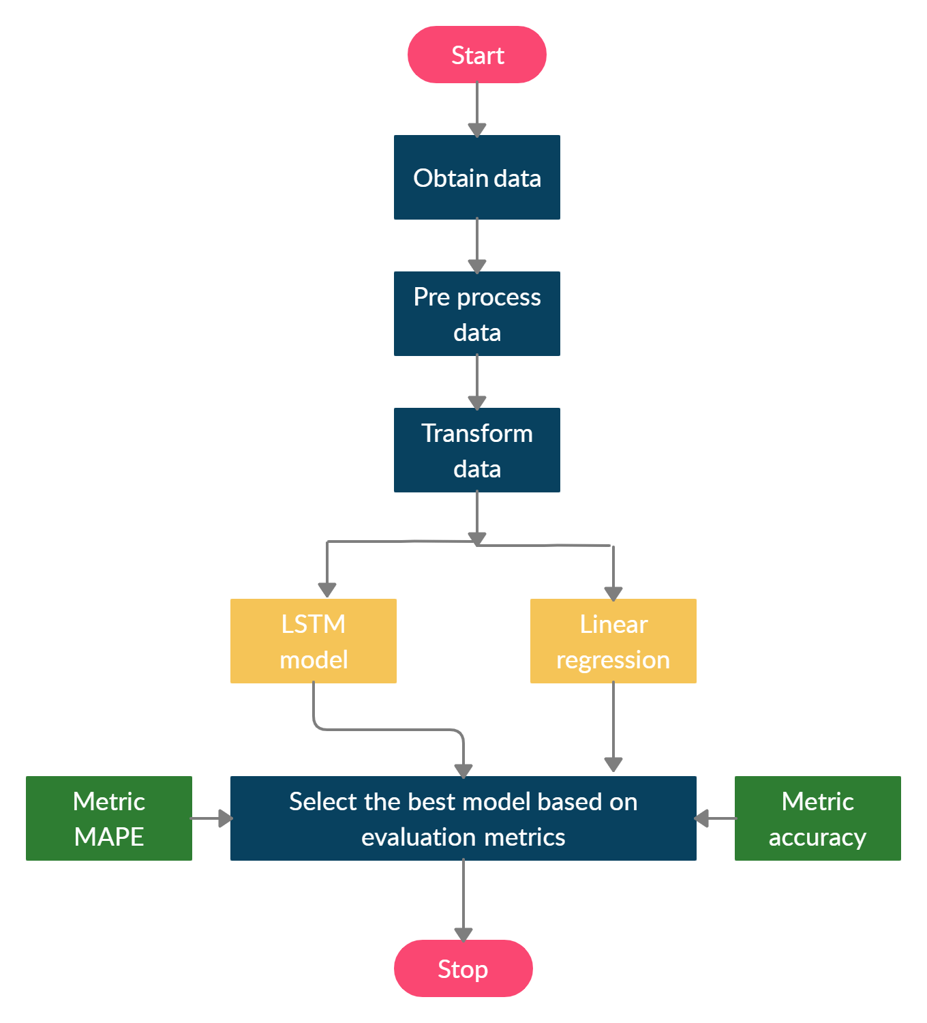
METHODOLOGY

Slide 7

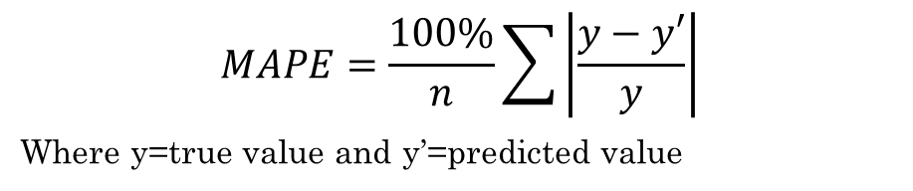
EVALUATION METRICS
Mean Absolute Percentage error It is defined by the following formula:
$$MAPE=\frac{100\%}{n}\sum{\left|\frac{y−y′}{y}\right|}$$
Where y=true value and y’=predicted value
Accuracy It is defined by the following formula:
Accuracy=(100-MAPE)%

Slide 8
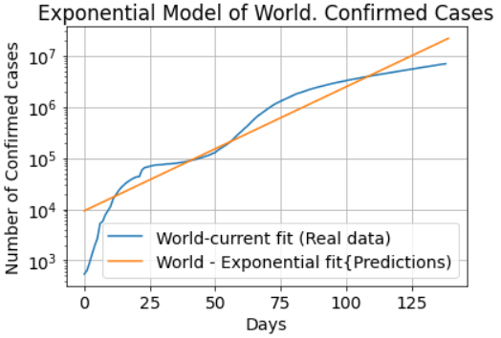
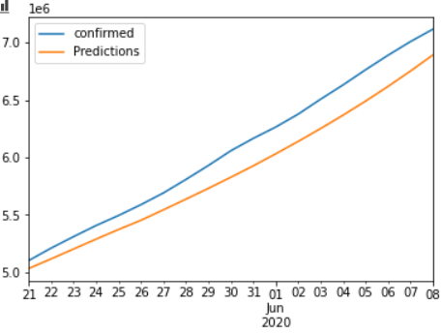
RESULT AND ANALYSIS
Using Linear Regression
Using LSTM
MAPE:6.42%
ACCURACY:93.57%
MAPE:3.092%
ACCURACY:96.90%

Slide 9
CONCLUSION AND FUTURE WORK
The LSTM model is able to perform slightly better than the linear regression model and has the accuracy of about 96.90%.So choosing LSTM would be a better choice.
Since the data is updated regularly the model can also be made to update and train on the updating data to keep up with the current trend.
Moreover since the data consist of country wise cases so the model could be made to work for specific country rather than worldwide.
Hence with the help of this model different countries government can get a rough estimate as to how much the case would increase in near future and can take preventive measures accordingly.

Slide 10
REFERENCES
[1] Bandyopadhyay, Samir Kumar, and Shawni Dutta. "Machine learning approach for confirmation of covid-19 cases: Positive, negative, death and release." medRxiv (2020).
[2] Ayyoubzadeh, Seyed Mohammad, et al. "Predicting COVID-19 incidence through analysis of google trends data in iran: data mining and deep learning pilot study." JMIR Public Health and Surveillance 6.2 (2020): e18828.
[3] C. Huang et al., “Clinical features of patients infected with 2019 novel coronavirus in Wuhan China,” Lancet, vol. 395, no. 10223, pp. 497–506, 2020, doi: 10.1016/S0140-6736(20)301835
[4] Z. Hu, Q. Ge, S. Li, L. Jin, and M. Xiong, “Artificial Intelligence Forecasting of Covid-19 in China,” pp. 1–20, 2020.
[5] S. Bouktif, A. Fiaz, A. Ouni, and M. A. Serhani, “Optimal deep learning LSTM model for electric load forecasting using feature selection and genetic algorithm: Comparison with machine learning approaches,” Energies, vol. 11, no. 7, 2018, doi: 10.3390/en11071636.

Slide 11
REFERENCES
[6] Yang, Zifeng, Zhiqi Zeng, Ke Wang, Sook-San Wong, Wenhua Liang, Mark Zanin, Peng Liu et al. "Modified SEIR and AI prediction of the epidemics trend of COVID-19 in China under public health interventions." Journal of Thoracic Disease 12, no. 3 (2020): 165.
[7] Tomar, Anuradha, and Neeraj Gupta. "Prediction for the spread of COVID-19 in India and effectiveness of preventive measures." Science of The Total Environment (2020): 138762.
[8] Pal, Ratnabali, Arif Ahmed Sekh, Samarjit Kar, and Dilip K. Prasad. "Neural network based country wise risk prediction of COVID-19." arXiv preprint arXiv:2004.00959 (2020).
[9] Pandey, Gaurav, Poonam Chaudhary, Rajan Gupta, and Saibal Pal. "SEIR and Regression Model based COVID-19 outbreak predictions in India." arXiv preprint arXiv:2004.00958 (2020).
[10]Yang, Zifeng, Zhiqi Zeng, Ke Wang, Sook-San Wong, Peng Liu et al. "Modified SEIR and AI prediction of the epidemics trend of COVID-19 in China under public health interventions." Journal of Thoracic Disease 12, no. 3 (2020): 165.

Slide 12
Thank You

